Slide 1

ACTS

Slide 2
ACTS
Last recorded acts:
Matthew ~ Resurrection
Mark ~ Ascension
Luke ~ Promise of Holy Spirit
John ~ 2nd Coming
All in Acts 1

Slide 3
ACTS
Outline:
1-7 = Jerusalem
8-12 = Judea and Samaria
13-28 = end of the earth

Slide 4
ACTS
¹⁶ And I will pray the Father, and He will give you another Helper, that He may abide with you forever— ¹⁷ the Spirit of truth, whom the world cannot receive, because it neither sees
Him nor knows Him; but you
know Him, for He dwells with
you and will be in you. ¹⁸ I will
not leave you orphans; I will
come to you.
With ~ para
In ~ en
John 14.16-18

Slide 5
ACTS
But you shall receive power when the Holy Spirit has come upon you;
Upon ~ epi
Acts 1.8

Slide 6
ACTS
What does it mean to “receive” the Holy Spirit?
1. To get something; to come into possession of
2. To go through or exper-ience, i.e. "The player received minor injuries”
3. To express willingness
to have in one's home or environs, i.e. "The community gladly
received the refugees"

Slide 7
ACTS
And when He had said this, He breathed on them, and said to them, "Receive the Holy Spirit."
1. To get something; to come into possession of
John 20.22

Slide 8
ACTS
But you shall receive power when the Holy Spirit has come upon you; and you shall be witnesses to Me in Jerusalem, and in
all Judea and Samaria,
and to the end of the earth.
2. To go through or experience
Acts 1. 8

Slide 9
ACTS
Then Peter said to them, "Repent, and let every one of you be baptized in the name of Jesus Christ for the remission of
sins; and you shall receive
the gift of the Holy
Spirit."
1. To get something; to come into possession of
Acts 2. 38

Slide 10
ACTS
¹⁴ Now when the apostles who were at Jerusalem heard that Samaria had re-ceived the word of God, they sent Peter and John to them, ¹⁵ who, when they had come down, prayed for them that
they might receive the Holy
Spirit. ¹⁶ For as yet He had fall-
en upon none of them. They had
only been baptized in thename of
the Lord Jesus. ¹⁷ Then they
laid hands on them, and they
received the Holy Spirit.
2. To go through or experience
Acts 8. 14-17

Slide 11
ACTS
¹⁴ Now when the apostles who were at Jerusalem heard that Samaria had re-ceived the word of God, they sent Peter and John to them, ¹⁵ who, when they had come down, prayed for them that
they might receive the Holy
Spirit. ¹⁶ For as yet He had fall-
en upon none of them. They had
only been baptized in thename of
the Lord Jesus. ¹⁷ Then they
laid hands on them, and they
received the Holy Spirit.
2. To go through or experience
Acts 8. 14-17

Slide 12
ACTS
he said to them, “Did you receive the Holy Spirit when you believed?”
So they said to him, “We
have not so much as heard whether there is a Holy
Spirit.”
2. To go through or experience
Acts 19.2

Slide 13
ACTS
"I recall the exact spot where I was kneeling in prayer in my study … It was a very quiet moment, one of the most quiet moments I ever knew … Then God simply said to me,
not in any audible voice, but in
my heart, 'It's yours. Now go
and preach.' He had already
said it to me in His Word in 1
John 5:14, 15; but I did not
then know my Bible as I
know it now, and God had
pity on my ignorance and said it directly to my soul … I went and preached, and I have been a new minister from that day to this … Some time after this experience (I
do not recall just how long
after), while sitting in my room
one day … suddenly … I found
myself shouting (I was not
brought up to shout and I am
not of a shouting tempera-
ment, but I shouted like the
loudest shouting Methodist), 'Glory to God, glory to God, glory to God,' and I could not stop … But that was not when I was baptized with the Holy Spirit. I was baptized with the Holy
Spirit when I took Him by
simple faith in the Word of
God.”
R. A. Torrey

Slide 14
ACTS
"I was crying all the time that God would fill me with his Spirit. Well, one day, in the city of New York – oh what a day! – I cannot describe it, I seldom refer to it; it is almost too
sacred an experience to name.
Paul had an experience of
which he never spoke for four-
teen years. I can only say
that God revealed Himself
To me, and I had such an ex-
perience of His love that I
had to ask Him to stay His hand. I went preaching again. The sermons were not different; I did not present any new truths; and yet hundreds were converted, I would not now be
placed back where I was be-
fore that blessed experience if
you should give me all the world
– it would be as the small dust
of the balance."
D. L. Moody

Slide 15
ACTS
“Charismania”
Cessationism
Azuza
Street
Revival
of 1906
R. A. Torrey
Teaching on the Holy Spirit
the first
1900 years
Dwight. Moody
Charles Finney
A. B. Simpson

Slide 16
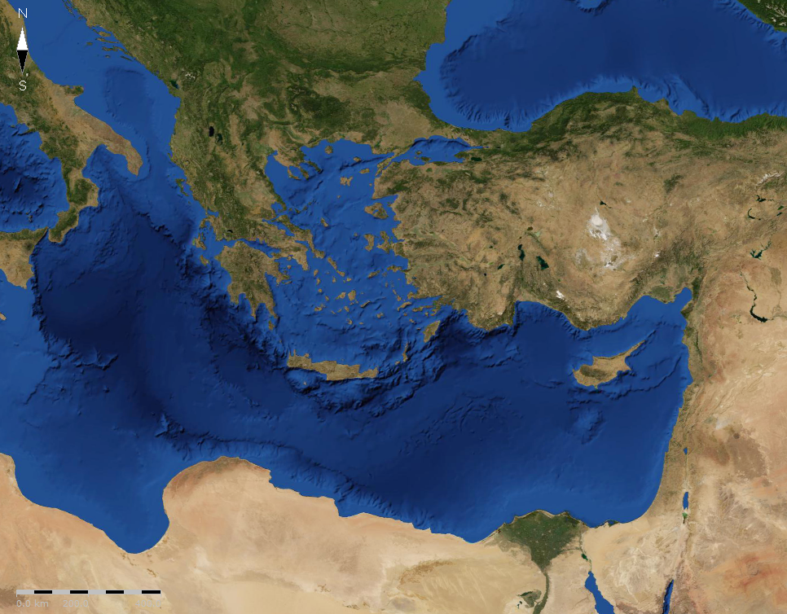
ACTS
Bithynia
Troas
Phrygia
Asia

Slide 17
ACTS
"You can call it whatever you want to call it, but I'd rather have the right thing with the wrong name than the wrong thing with
the right name any day."
R. A. Torrey

Slide 18
ACTS
3. To express willingness to have in one's home or environs, i.e. "The community gladly received the refugees"

